Slide 1
Economic Systems

Slide 2
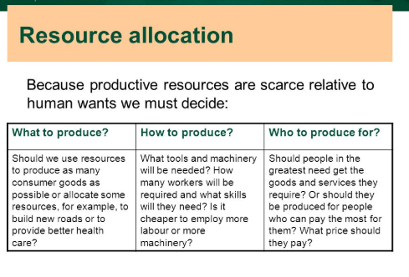

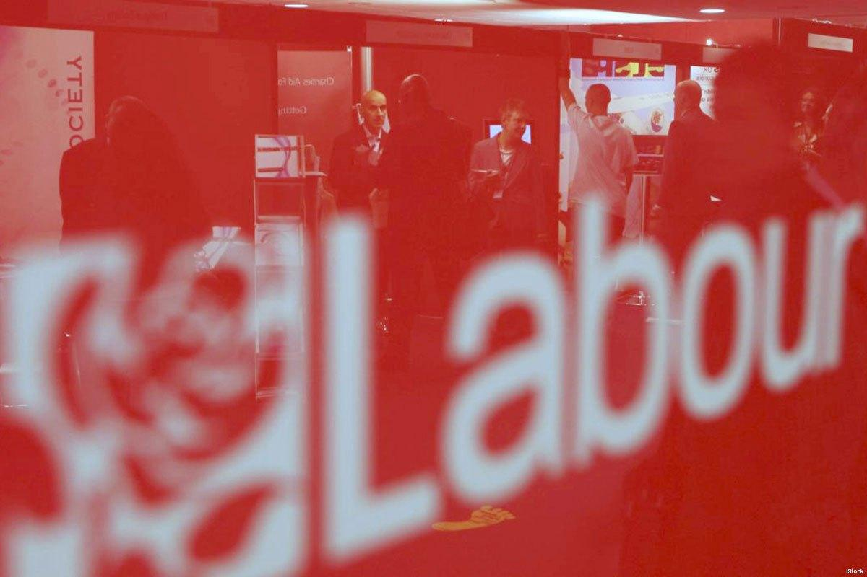

Objective:
To be able to explain how resources are allocated in different economic systems
Outcome:
Define Resource Allocation
Identify different economic systems
Analyse features, advanatges and disadvantages of planned economy
Objective:
To be able to explain how resources are allocated in planned economy
Outcome:
Define Resource Allocation
Explain Features of Planned Economy
Analyse advanatges and disadvantages of planned economy
Extension:
Differentiate between planned and market economy

Slide 3
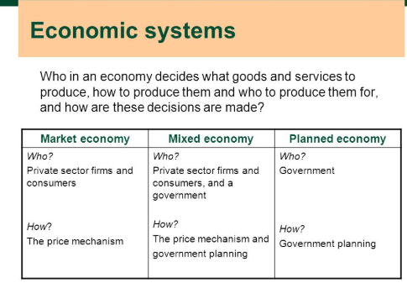
Objective:
To be able to explain how resources are allocated in different economic systems
Outcome:
Define Resource Allocation
Identify different economic systems
Analyse features, advanatges and disadvantages of planned economy

Slide 4
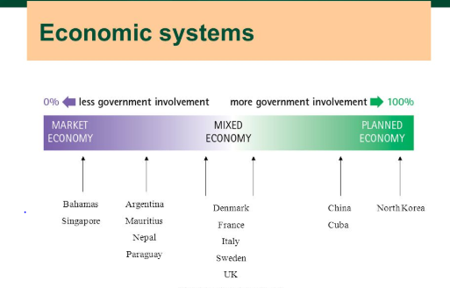
Objective:
To be able to explain how resources are allocated in different economic systems
Outcome:
Define Resource Allocation
Identify different economic systems
Analyse features, advanatges and disadvantages of planned economy

Slide 5
https://youtu.be/Cpqq9HXYJPM

Slide 6
Planned Economic System:
Objective:
To be able to explain how resources are allocated in different economic systems
Outcome:
Define Resource Allocation
Identify different economic systems
Analyse features, advanatges and disadvantages of planned economy
All decisions are made by the government. They decide what to produce, how to produce and for whom to produce. Example: North Korea.
Features:
1. All resources are owned and allocated by the govt. They also fix the prices.
2. Profit is not the main motive- social welfare is.
3. They produce goods that will be most beneficial to the social welfare of the economy.
4. Efficiency may not be the highest priority as profit isn’t a motive. Thus they could use inefficient production methods to produce the goods.
5. Goods will be produced for all people- mainly those with poor incomes. Rich people may demand for luxury goods, which the govt. might not be interested in producing.

Slide 7
Advantages:
Objective:
To be able to explain how resources are allocated in different economic systems
Outcome:
Define Resource Allocation
Identify different economic systems
Analyse features, advanatges and disadvantages of planned economy
1. As it’s a welfare-motive economy, it will produce necessities (food/water/clothes), public goods and merit goods.
2. Prices are kept low, so it’s affordable for everyone.
3. Low unemployment can exist as the govt. aims at full employment.
4. Since there is no competition, duplication of products is eliminated.

Slide 8
Disadvantages:
Objective:
To be able to explain how resources are allocated in different economic systems
Outcome:
Define Resource Allocation
Identify different economic systems
Analyse features, advanatges and disadvantages of planned economy
1. Consumer sovereignty is low as the govt. decides what to produce.
2. Lack of profit motive may lead to firms being inefficient.

Slide 9
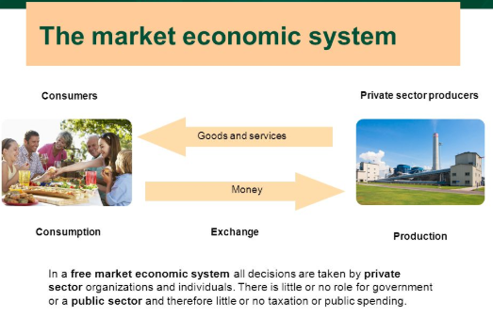

Slide 10
The Market* Economic System
Free Market Economic system: All decisions are made by private individuals; that is, there is no government intervention or involvement in resource allocation.
(There are virtually no economies in the world who follow this-there is a government control everywhere, though USA does come close).
Features:
1. All resources are owned and allocated by private individuals. No govt. control exists.
2. profit is the main-motive
3.The demand and supply fixes the price of products. This is called price mechanism
.
4.What to produce is solved by producing the most-demanded goods for which people spend a lot, as their only motive is to generate a high profit.
5. How to produce is solved by using the cheapest yet efficient combination of resources– capital or labour- in order to maximise profits.
6. For whom to produce is solved by producing to people who are willing and able to pay for goods at a high price.
7.CONSUMER SOVEREIGNITY :Consumer sovereignty is an economic concept where the consumer has some controlling power over goods that are produced, and the idea that the consumer is the best judge of their own welfare. In market economic system, consumer sovereignity is the highest.
Objective:
To be able to explain how resources are allocated in market economy
Outcome:
Define market System
Explain Features of market System
Analyse Advanatges and Disadvantages of market system
Extension:
Differentiate between planned and market economy

Slide 11
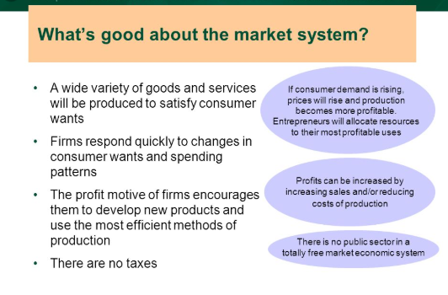
Objective:
To be able to explain how resources are allocated in market economy
Outcome:
Define market System
Explain Features of market System
Analyse Advanatges and Disadvantages of market system
Extension:
Differentiate between planned and market economy

Slide 12
Disadvantages:
1. Only profitable goods and services are produced. Public goods* and some merit goods* for which there is no demand may not be produced, which is a drawback and affects the economic development.
2. Firms will only produce for consumers who can pay for them. Poor people who cannot spend much won’t be produced for, as it would be non-profitable.
3. Some resources will be left unused.
4. Harmful (demerit) goods may be produced if it is profitable to do so.
5. Negative impacts on society may be ignored by producers, as their sole motive is to keep consumers satisfied and generate a high profit.
6. A firm that are able to dominate or control the market supply of a product is called a monopoly.
7. Due to high competition between firms, duplication of products may take place, which is a waste of resources.
Objective:
To be able to explain how resources are allocated in market economy
Outcome:
Define market System
Explain Features of market System
Analyse Advanatges and Disadvantages of market system
Extension:
Differentiate between planned and market economy

Slide 13
Extension:
Objective:
To be able to explain how resources are allocated in market economy
Outcome:
Define market System
Explain Features of market System
Analyse Advanatges and Disadvantages of market system
Extension:
Differentiate between planned and market economy
Differentiate between market economy and planned economy

Slide 14
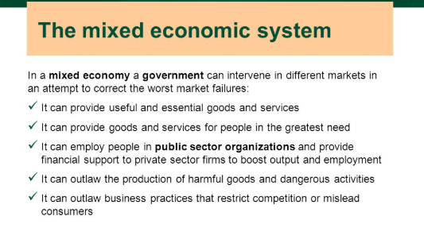
“Mixed economy is that economy in which both government and private individuals exercise economic control.”
Objective:
To be able to explain how resources are allocated in mixed economy
Outcome:
Define Mixed Economy
Explain Features of Mixed Economy
Analyse Advanatges and Disadvantages of Mixed Economy
Extension:
Differentiate between Planned economy and mixed economy

Slide 15
Advantages:
1. The govt. can provide public goods, necessities and merit goods. The private businesses can provide most-demanded goods (luxury goods, superior goods). Thus, everyone is provided for.
2. The govt. will keep externalities, monopolies, harmful goods etc. in control.
3. The govt. can provide jobs in the public sector (so there is better job security).
4. The govt. can also provide financial help to collapsing private organizations, so jobs are kept secure.
Objective:
To be able to explain how resources are allocated in mixed economy
Outcome:
Define Mixed Economy
Explain Features of Mixed Economy
Analyse Advanatges and Disadvantages of Mixed Economy
Extension:
Differentiate between market economy and mixed economy

Slide 16
Disadvantages:
Objective:
To be able to explain how resources are allocated in mixed economy
Outcome:
Define Mixed Economy
Explain Features of Mixed Economy
Analyse Advanatges and Disadvantages of Mixed Economy
Extension:
Differentiate between market economy and mixed economy
1. Govt. taxes will be imposed, which will raise prices and also reduce work incentive.
2. Govt. laws and regulations can increase production costs and reduce production.
3. Public sector organizations may still be inefficient and will produce low quality goods and services.
4. Personal Gain of the government

Slide 17
Objective:
To be able to explain how resources are allocated in mixed economy
Outcome:
Differentiate between market economy and mixed economy
Analyse the sectors in an economy
Differentiate between Mixed economy and Planned Economy

Slide 18
Sectors in an economy
Objective:
To be able to identify different sectors in the economy
Outcome:
Identify different sectors in the economy
Explain the sectors in an economy with real life examples
Production in an economy can be divided into three types:
Primary sector: this involves the use/extraction of natural resources. Examples include agricultural activities, mining, fishing, wood-cutting, oil drilling etc.
Secondary sector: this involves the manufacture of goods using the resources from the primary sector. Examples include auto-mobile manufacturing, steel industries, cloth production etc.
Tertiary sector: this consist of all the services provided in an economy. This includes hotels, travel agencies, hair salons, banks etc.

Slide 19
ACTIVITIES
Objective:
To be able to identify different sectors in the economy
Outcome:
Identify different sectors in the economy
Explain the sectors in an economy with real life examples
Think/Pair/Share
Page 33 – Activity 2.6
Page 36 – Activitiy 2.7
Group Activity
Crossword – Page 38

